Slide 1
Data Mining Project: Insight of NYC districts regarding the tobacco licensing system for soon to be tobacco business owner, Josh.
Alvin Munar
Katherine Gallego

Slide 2
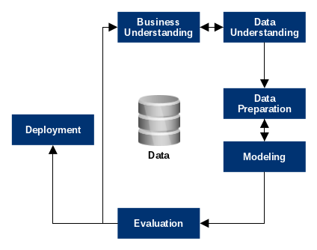
Data Mining Process
With the help of CRISP-DM, we can easily implement a process of steps for data mining and analysis.
CRISP-DM (Cross-Industry Standard Process for Data Mining) is a detailed model consisting of 6 steps which include:
1. Business Understanding
2. Data understanding
3. Data Preparation
4. Modeling
5. Evaluation
6. Deployment

Slide 3
Business Problem
Josh is a prospective business owner and wants to open shop. He is uncertain that opening up a shop in a district where there is a high volume of tobacco retailers will have more competition and become less profitable. Should Josh decide to open a shop in a district where there is less volume of smoke shops?
Solution: Josh will rely on a dataset to see which area has the less amount of smoke shops so he has less competition.

Slide 4
Business Understanding
We need a dataset to understand the objectives for the project and understand the intended goals. From there, we can determine what the problem is going to be.
How will data mining answer the business problem?
Data mining solution will give us a better perspective of how to approach a business problem using a data set.
The purpose of this project is to provide an overview/insight of a tobacco licensing system that includes the quantity, location and type of tobacco product while complying to government regulation.
We want to dissect whether or not it will be beneficial to open a smoke shop in a district with a higher concentration of tobacco retail shops vs. a lower concentration of tobacco retail shops.

Slide 5
Business Understanding cont.
We will utilize data from NYC open data from 2020 in order to construct Machine Learning Models (Supervised data mining). The models will denote which district will best predict where Josh can open his smoke shop.
How (precisely) will a data mining solution address the business problem?
Among the districts, where is it likely that Josh will open up his smoke shop?
Will using regression to estimate or predict whether Josh will be more susceptible in opening his smoke shop business in a district where there is more or less of a presence in smoke shop businesses?
Similarly, we believe that by implementing clustering methods might help denote concentrations of tobacco localities and can help Josh to make a suitable choice on where to put his smoke shop.

Slide 6
Data Analysis
We found a reliable data from NYC Open Data 2020. (NYCOpenData)
We will use the data aggregated from the NYC Open Data to find a solution on the business problem and see if data mining will help prove the answer to the solution.
Similarly, we can use this community district map to locate each tobacco licensed retail shop. (Craig Newark Graduate School of Journalism) (NYC Planning | Community Profiles)
We obtained a total of number of Tobacco Retail Dealer licenses allowed throughout the districts of NYC (n=3879) known as supervised data.

Slide 7
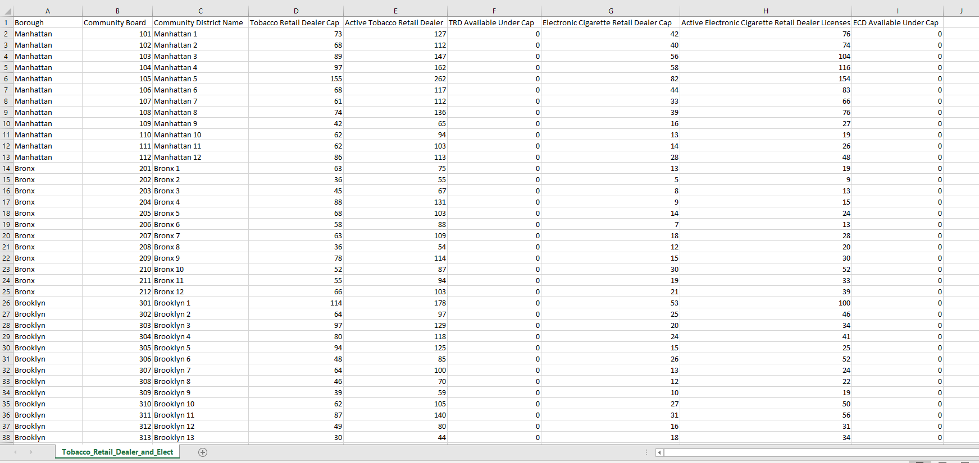
Tobacco Retail Dealer and Electronic Cigarette Retail Dealer Caps by Community District

Slide 8
Data Understanding cont.
In the data, it shows the attributes such as:
Borough: Where the business is located.
Community Board: Community District Number where the Business is located.
Community District Name
Tobacco Retail Dealer Cap: Maximum number of Tobacco Retail Dealer licenses allowed in the Community District. Calculated as 50 percent of the number of active non-pharmacy Tobacco Retail Dealer licenses as of the cutoff date (February 24, 2018).
Active Tobacco Retail Dealer Licenses: Number of active Tobacco Retail Dealer licenses in the Community District as of the last run date of the report, minus all Tobacco Retail Dealer licenses held by pharmacies.

Slide 9
Data Understanding cont.
TRD (Tobacco Retail Dealer) Under Cap
Electronic Cigarette Retail Dealer Cap: Maximum number of Electronic Cigarette Retail Dealer licenses assigned to the Community District. Calculated as 50 percent of the number of active Electronic Cigarette Retail Dealer licenses as of the cutoff date (August 23, 2018).
Active Electronic Cigarette Retail Dealer Licenses: Number of active Electronic Cigarette Retail Dealer licenses in the Community District as of the last run date of the report.
ECD Available Under Cap

Slide 10
Data Preparation
Data will be used from NYC Open Data:
Tobacco Retail Dealer and Electronic Cigarette Retail Dealer Caps by Community District
We will concentrate on the Sum of Active Tobacco Retail Dealer Licenses and the Sum of Tobacco Retail Dealer Cap.
Based on the dataset, we used a pivot table to show which borough, then district has the less densely populated smoke shop.
The pivot table provided better insight of the aggregated data.
The Bronx consists of districts 1-10, the following districts with neighborhoods are listed:
Bronx District 1: Melrose, Mott Haven, Port Morris
Bronx District 2: Hunts Point, Longwood
Bronx District 3: Claremont, Crotona Park East, Melrose, Morrisania
Bronx District 4: Concourse, Concourse Village, East Concourse, HIghbridge, Mount Eden
Bronx District 5: Fordham, Morris Heights, Mount Hope, University Heights

Slide 11
Data Preparation cont.
The Bronx consists of districts 1-12, the following districts with neighborhoods are listed:
Bronx District 6: Bethgate, Belmont, Bronx Park South, East Tremont, West Farms
Bronx District 7: Bedford Park, Fordham, Kingsbridge Heights, Norwood, University Heights
Bronx District 8: Fieldston, Kingsbridge, Marble Hill, North Riverdale, Riverdale, Spuyten Duyvil
Bronx District 9: Bronx River, Castle Hill, Clason Point, Harding Park, Parkchester, Soundview, Soundview-Bruckner, Unionport
Bronx District 10: City Island, Co-op City, Country Club, Edgewater Park, Pelham Bay, Schuylerville, Throgs Neck, Westchester Square
Bronx District 11: Allerton, Bronxdale, Indian Village, Morris Park, Pelham Gardens, Pelham Parkway, Van Nest
Bronx District 12: Baychester, Eastchester, Edenwald, Olinville, Wakefield, Williamsbridge, Woodlawn.

Slide 12
Data Preparation
Manhattan consists of districts 1-12, the following districts with neighborhoods are listed below:
Manhattan District 1: Battery Park City, Civic Center, Ellis Island, Governors Island, Liberty Island, South Street Seaport, Tribeca, Wall Street, World Trade Center
Manhattan District 2: Greenwich Village, Hudson Square, Little Italy, NoHo, SoHo, South Village, West VIllage
Manhattan District 3: Claremont, Crotona Park East, Melrose, Morrisania
Manhattan District 4: Chelsea, Clinton, Hudson Yards
Manhattan District 5: Flatiron, Gramercy Park, Herald Square, Midtown, Midtown South, Murray Hills, Times Square, Union Square
Manhattan District 6: Beekman Place, Gramercy Park, Murray Hill, Peter Cooper Village, Stuyvesant Town, Sutton Place, Tudor City, Turtle Bay
Manhattan District 7: Lincoln Square, Manhattan Valley, Upper West Side
Manhattan District 8: Carnegie Hill, Lenox Hill, Roosevelt Island, Upper East Side, Yorkville
Manhattan District 9: Hamilton Heights, Manhattanville, Morningside Heights, West Harlem
Manhattan District 10: Central Harlem
Manhattan District 11: East Harlem, Harlem, Randall’s Island Park, Wards Island Park
Manhattan District 12: Inwood, Washington Heights

Slide 13
Data Preparation
Brooklyn consists of districts 1-18, the following districts with neighborhoods are listed below:
Brooklyn District 1: East Williamsburg, Greenpoint, Northside, Southside, Williamsburg
Brooklyn District 2: Boerum Hill, Brooklyn Heights, Clinton Hill, Downtown Brooklyn, DUMBO, Fort Greene, Fulton Ferry, Navy Yard, Vinegar Hill
Brooklyn District 3: Bedford-Stuyvesant, Stuyvesant Heights, Tompkins Park North
Brooklyn District 4: Bushwick
Brooklyn District 5: Broadway Junction, City Line, Cypress Hills, East New York, Highland Park, New Lots, Spring Creek, Starrett City
Brooklyn District 6: Carroll Gardens, Cobble Hill, Columbia St, Gowanus, Park Slope, Red Hook
Brooklyn District 7: Sunset Park, Windsor Terrace
Brooklyn District 8: Crown Heights, Prospect Heights, Weeksville
Brooklyn District 9: Crown Heights South, Prospect Lefferts Garden, Wingate
Brooklyn District 10: Bay Ridge, Dyker Heights, Fort Hamilton
Brooklyn District 11: Bath Beach, Bensonhurst, Gravesend, Mapleton
Brooklyn District 12: Borough Park, Kensington, Ocean Parkway
Brooklyn District 13: Brighton Beach, Coney Island, Gravesend, Homecrest, Sea Gate, West Brighton
Brooklyn District 14: Ditmas Park, Flatbush, Manhattan Terrace, Midwood, Ocean Parkway, Prospect Park South
Brooklyn District 15: Gerritsen Beach, Gravesend, Homecrest, Kings Highway, Manhattan Beach, Plumb Beach, Sheepshead Bay
Brooklyn District 16: Broadway Junction, Brownsville, Ocean Hill
Brooklyn District 17: East Flatbush, Farragut, Flatbush, Northeast Flatbush, Remsen Village, Rugby, Erasmus
Brooklyn District 18: Bergen Beach, Canarsie, Flatlands, Georgetown, Marine Park, Mill Basin, Mill Island, Paerdegat Basin

Slide 14
Data Preparation
Queens consists of districts 1-14, the following districts with neighborhoods are listed below:
Queens District 1: Astoria, Astoria Heights, Queensbridge, Dutch Kills, Long Island City, Ravenswood, Rikers Island (BX), Steinway
Queens District 2: Blissville, Hunters Point, Long Island City, Sunnyside, Sunnyside Gardens, Woodside
Queens District 3: East Elmhurst, Jackson Heights, North Corona
Queens District 4: Corona, Corona Heights, Elmhurst, Lefrak City
Queens District 5: Glendale, Maspeth, Middle Village, Ridgewood
Queens District 6:Forest Hills, Forest Hills Gardens, Rego Park
Queens District 7: Auburndale, Bay Terrace, Beechhurst, Clearview, College Point, Downtown Flushing, East Flushing, Flushing, Malba, Murray Hill, Queensboro Hill, Waldheim, Whitestone
Queens District 8: Briarwood, Fresh Meadows, Hillcrest, Holliswood, Jamaica, Jamaica Estates, Jamaica Hills, Kew Gardens Hills, Pomonok, Utopia
Queens District 9: Kew Gardens, Ozone Park, Richmond Hill, Woodhaven
Queens District 10: Howard Beach, Lindenwood, Old Howard Beach, Ozone Park, South Ozone Park
Queens District 11: Auburndale, Bayside, Douglaston, Hollis Hills, Little Neck, Oakland Gardens
Queens District 12: Hollis, Jamaica, Jamaica Center, North Springfield Gardens, Rochdale, South Jamaica, St. Albans
Queens District 13: Bellaire, Bellerose, Brookville, Cambria Heights, Floral Park, Glen Oaks, Laurelton, New Hyde Park, Queens Village, Rosedale, Springfield Gardens
Queens District 14: Arverne, Bayswater, Belle Harbor, Breezy Point, Broad Channel, Edgemere, Far Rockaway, Hammels, Neponsit, Rockaway Park, The Rockaways, Roxbury, Seaside, Somerville

Slide 15
Data Preparation
Staten Island consists of districts 1-3, the following districts with neighborhoods are listed below:
Staten Island District 1: Arlington, Castleton Corners, Clifton, Elm Park, Fox Hills, Graniteville, Grymes Hill, Howland Hook, Livingston, Mariners Harbor, New Brighton, Old Place, Park Hill, Port Ivory, Port Richmond, Randall Manor, Rosebank, Shore Acres, Silver Lake, St. George, Stapleton, Sunnyside, Tompkinsville, Ward Hill, West Brighton, West New Brighton, Westerleigh, Willowbrook
Staten Island District 2: Arrochar, Bloomfield, Bulls Head, Chelsea, Concord, Dongan Hills, Egbertville, Emerson Hill, Grant City, Grasmere, Heartland Village, Lighthouse Hill, Manor Heights, Midland Beach, New Dorp, New Dorp Beach, New Springville, Old Town, South Beach, Todt Hill, Travis, Willowbrook
Staten Island District 3: Annadale, Arden Heights, Bay Terrace, Butler Manor, Charleston, Eltingville, Fresh Kills, Great Kills, Greenridge, Huguenot, Oakwood, Oakwood Beach, Oakwood Heights, Pleasant Plains, Prince's Bay, Richmond Town, Richmond Valley, Rossville, Sandy Ground, Tottenville, Woodrow

Slide 16
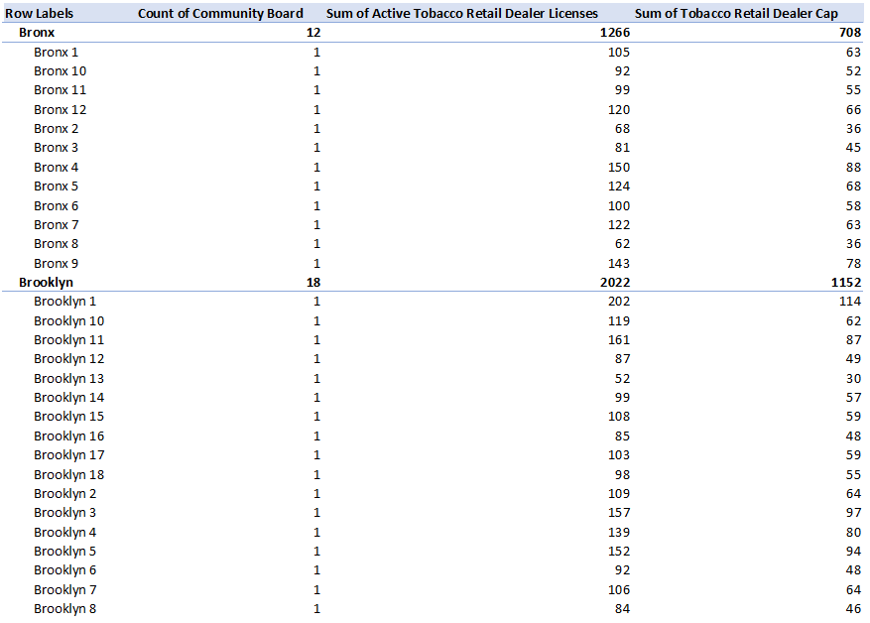
Data Preparation cont.
For this Pivot table model, we focused on the sum of Tobacco Retail Dealer, Cap in relation to the districts for each borough.
Bronx shows that it has 1266 active tobacco retail dealer cap across its 12 Community Board.
Brooklyn has 2022 active retail dealer cap across 18 board.

Slide 17
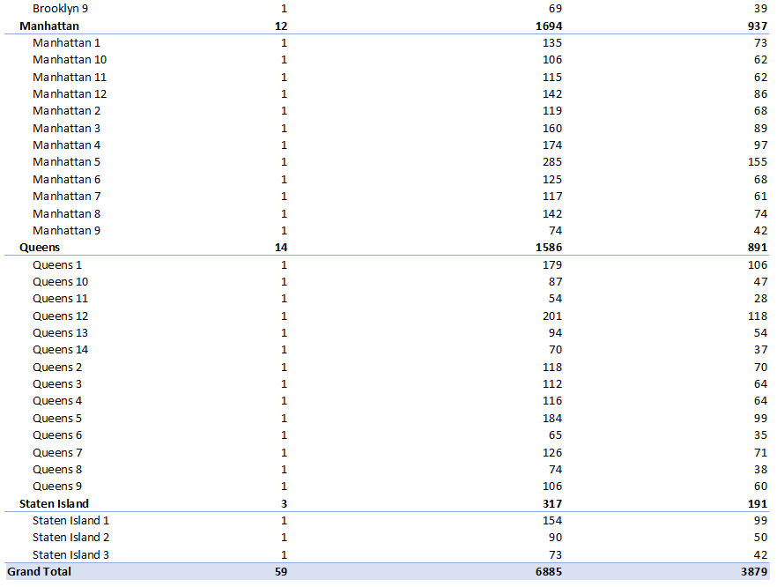
Data Preparation cont.
Manhattan has 12 Community Board and 1694 active tobacco dealer.
Queens has 14 Community Board and 1586 active dealers.
Staten Island has 317 active tobacco retail dealer and 3 community board.

Slide 18
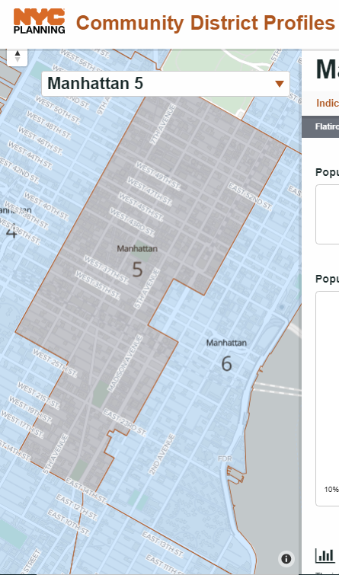
Data Preparation cont.
District 5 of Manhattan, which is all of Flatiron, Gramercy Park, Herald Square, Midtown, Midtown South, Murray Hill, Times Square, Union Square, has 155 retailer tobacco shops.
There are 285 active active licenses but don’t have a shop set up yet will eventually set up a shop.
District 5 has the highest concentration number of smoke shops out of all the districts and boroughs.
With the highest concentration number of smoke shops, we conclude that competition is highly visible creating an environment inducing more smoke usage.

Slide 19
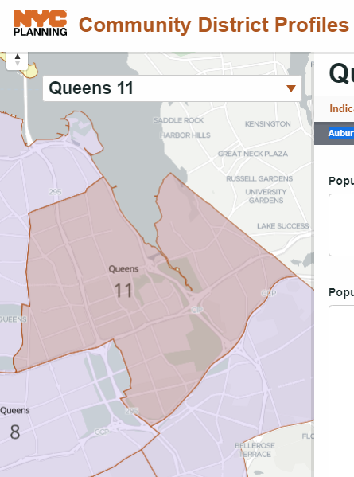
Data Preparation cont.
District 11 of Queens Auburndale, Bayside, Douglaston, Hollis Hills, Little Neck, Oakland Gardens has 28 retailer tobacco shops.
There are 54 active licenses but don't have a shop set up yet but will eventually set up a shop.
Similarly, we analyzed that District 11 in Queens had the lowest concentration number of smoke shops.
With the lowest concentration number of smoke shops, we conclude that competition is low visible creating an environment inducing less smoke usage.

Slide 20
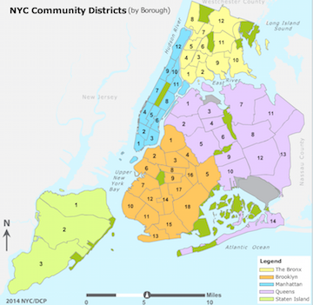
Data Preparation cont.
These findings may reflect consumer demand.
We concluded that convenience and proximity play a factor in District 11 of Queens.
Queens District 11 is considered to be more rural in comparison to District 5 of Manhattan.
It would be more convenient to set up a store at walking distance for consumers.

Slide 21
Modelling
Based on the data we gathered using pivot tables to visualize the amount of smoke shop per district.
We looked at how many district there are in each borough and by using a pivot table we can see how many smoke shops are in each district.
We can use a supervised data mining technique. With regression to determine the best possible outcome for where Josh can set up shop.
Clustering algorithms such as K-means clustering, are noted as a distance-based method that create clusters so that the intra-cluster variation is minimized. In each cluster for k-means, it is represented by a centroid which represents a mean of points assigned to the cluster.
This should solve the business problem because the algorithm will indicate where the best possible outcome should be. It helps determine where the least amount of smokes shop will be.

Slide 22
Modelling cont.
Pros:
Regression attempts to estimate the numerical value of the smoke shops per district and cross reference that with the maps of each district to determine the density of the district. (NYC Community District Profiles)
The algorithm has data inputs and specific targets and will use the data to predict the outcome.
Use Link Prediction to predict the connections between data items such as the smoke shops in the district with the borough.
Linear regression will optimize the model to fit the data.
Cons:
An unsupervised data mining technique can use profiling as a data mining task to profile the district to see which one has the most and least smokers. (NYC Community District Profiles)
Clustering can cluster all of the smoke shops in each district to a centroid which is the district. Then cluster the district to a centroid which is the borough to determine which borough has the least densely populated borough and district by smoke shops.
With clustering it will give the k-means of the value which is the density of the district/borough.
Co-occurence the amount of smoke shops with the amount of smokers in the district/borough.

Slide 23
Evaluation
We used linear regression to estimate or predict whether Josh will be more susceptible in opening his smoke shop business in a district where there is more or less of a presence in smoke shop businesses.
Similarly, classification technique can also be used to predict which borough and district in a given data to determine the most efficient location for a smoke shop.
Linear regression algorithm is mostly likely going to be the supervised data mining task because of the the algorithm will optimize to fit the model to the data.
The regression analysis results can also indicate that districts with a high number of distribution in active tobacco retail dealer licenses may have a correlation to the number of active smokers for each district.
Our goal for this study is to determine whether the distribution of tobacco licenses and the amount of active retail tobacco dealer will denote where the more profitable district will be in terms of how many active tobacco retailers are in each district?

Slide 24
Deployment
The results will indicate which borough then district has the least density of smoke shops.
Josh will then use that results to help make his decision on where he should set up his smoke shop.
There is no cyber ethical issues. No data is being mined from individuals or businesses regarding personal or important information.
Aside from cyber moral issues. There are health issues. This data is useful in terms of limiting the amount of tobacco retailers products throughout NYC districts. NYC is implementing strategies to reduce where and by whom tobacco products are sold.

Slide 25
References
https://communityprofiles.planning.nyc.gov/
https://researchguides.journalism.cuny.edu/NYCResearch
https://data.cityofnewyork.us/Business/Tobacco-Retail-Dealer-and-Electronic-Cigarette-Ret/ymyu-3dbp/data

